Slide 1
Flatiron School Capstone Project
COVID-19 PYTORCH IMAGE CLASSIFIER
CHRISTIAN LOPEZ
Notes:
- I’LL BE PRESENTING MY FLATIRON SCHOOL CAPSTONE PROJECT WHEREIN I CONSTRUCTED A COVID-19 PYTORCH IMAGE CLASSIFIER.

Slide 2

Problem statement
RAPIDLY MUTATING VIRUS
CURRENT KNOWLEDGE GAP
SPEED UP THE CURRENT TIMELINE
Notes:
THE COVID-19 VIRUS IS A RAPIDLY MUTATING AND DANGEROUS VIRUS.
THERE CURRENTLY EXISTS A SIGNIFICANT KNOWLEDGE GAP. WE DON’T YET KNOW MUCH ABOUT IT OR ANY OF THE LONG-TERM EFFECTS THAT MAY ARISE FROM AN INFECTION.
THE CONSTRUCTION OF AN EFFECTIVE IMAGE CLASSIFIER HAS THE POTENTIAL TO SPEED UP ANY CURRENT SCIENTIFIC WORK AND BRING US CLOSER TO A CURE.

Slide 3

Business value
EFFECTIVE DIAGNOSIS
INCREASED REVENUE
INTERNATIONAL RECOGNITION
Notes:
- BEING ABLE TO EFFECTIVELY DIAGNOSE PATIENTS CONTRACTED WITH COVID-19 IN A TIMELY MANNER.
- WILL BRING IN INCREASED REVENUE DUE TO MORE MEDICAL INSTITUTIONS UTILYZING THE CLASSIFIER AND MORE AND MORE PEOPLE BEING ACCURATELY DIAGNOSED.
- THE MODEL HAS THE POTENTIAL OF BEING RECOGNIZED AS BEING VERY RELIABLE THE MORE DATA IT IS TRAINED WITH, THEREBY BEING RECOGNIZED POSSIBLY WORLDWIDE.

Slide 4
METHODOLOGY
OBTAIN: COVID-19 CHEST X-RAY DATASET
01
SCRUB: MANIPULATED DATA USING PANDAS, NUMPY, TORCH
02
EXPLORE: CREATED VISUALIZATIONS USING MATPLOTLIB, PLOTLY, PIL
03
MODEL: USED TORCH AND TORCHVISION TO CREATE RESNET-18 CLASSIFIER
04
INTERPRET: DREW CONCLUSIONS FROM MODEL RESULTS
05
Notes:
UTILIZED THE COVID-19 CHEST X-RAY DATASET FROM KAGGLE
MANIPULATED THE DATA USING PANDAS, NUMPY, AND TORCH
CREATED VISUALIZATIONS USING MATPLOTLIB, PLOTLY, AND PIL
USED TORCH AND TORCHVISION TO CREATE THE RESENET-18 CLASSIFIER
DREW CONCLUSIONS FROM MODEL RESULTS

Slide 5
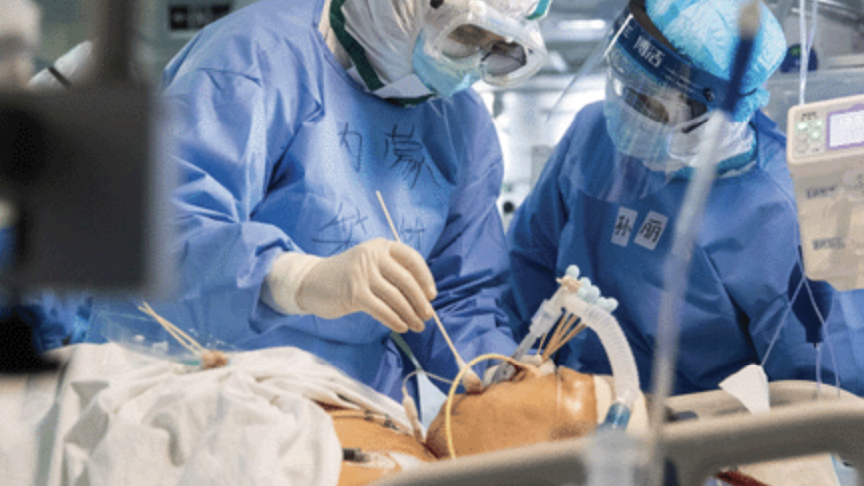
RECOMMENDATION 1
CLASSIFIER PLAYS ESSENTIAL ROLE IN CLINICAL AND TEACHING TASKS
Notes:
THE COVID-19 CLASSIFIER CAN PLAY A PIVOTAL ROLE IN CLINICAL AND TEACHING TASKS.
IT IS BEST IF THE CLASSIFIER IS IMPLEMENTED AS SOON AS POSSIBLE INTO THE DAILY WORKFLOW.
MEDICAL PRACTITIONERS CAN LEARN SIGNIFICANTLY FROM THE DECISIONS MADE BY THE CLASSIFIER AND ITS RESULTS CAN BE USED TO TEACH FUTURE MEDICAL PROFESSIONALS.

Slide 6
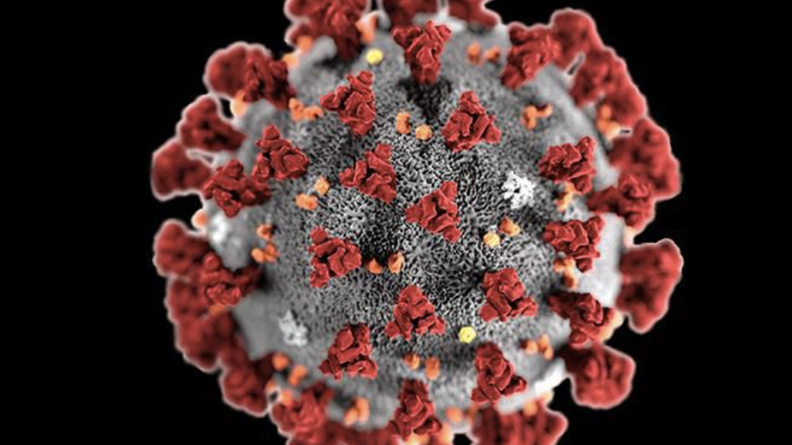
RECOMMENDATION 2
WIDESPREAD RELEASE AND IMPLEMENTATION OF THE CLASSIFIER
Notes:
THE IMAGE CLASSIFIER SHOULD BE RELEASED TO AS MANY MEDICAL INSTITUTIONS AS POSSIBLE.
IT SHOULD BE READILY AVAILABLE FOR ANYONE THAT WISHES TO UTILIZE IT ETHICALLY AND RESPONSIBLY.
THE MORE EXPOSURE, THE BETTER THE MODEL WILL LEARN HOW TO CORRECTLY CLASSIFY THE POTENTIALLY INFECTED INDIVIDUALS.

Slide 7
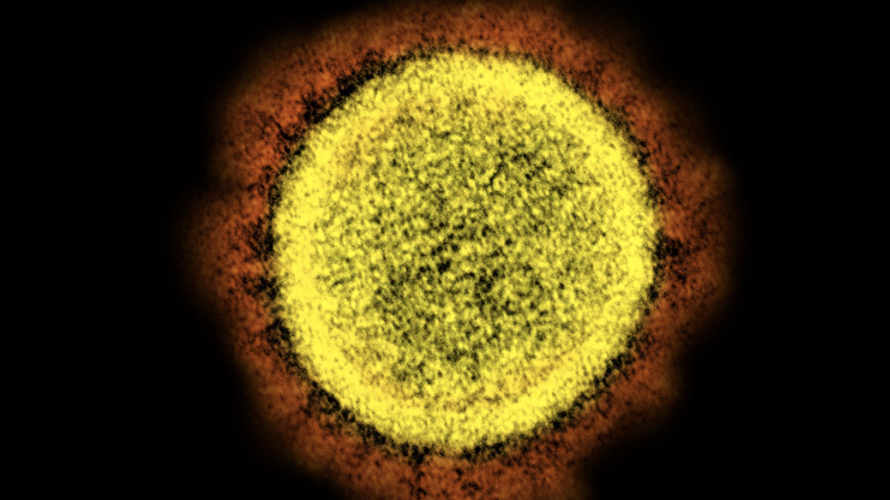
RECOMMENDATION 3
CLASSIFIER USED TO DETECT NOVEL STRAINS OF COVID
Notes:
THIS RESNET-18 IMAGE CLASSIFIER CAN BE UTILIZED IN A MYRIAD OF WAYS, INCLUDING BUT NOT LIMITED TO, THE DETECTION OF NEW STRAINS OF COVID.
THIS WOULD UNDOUBTABLY LEAD TO NOTEWORTHY DISCOVERIES AND ADVANCES IN THE MEDICAL FIELD.

Slide 8
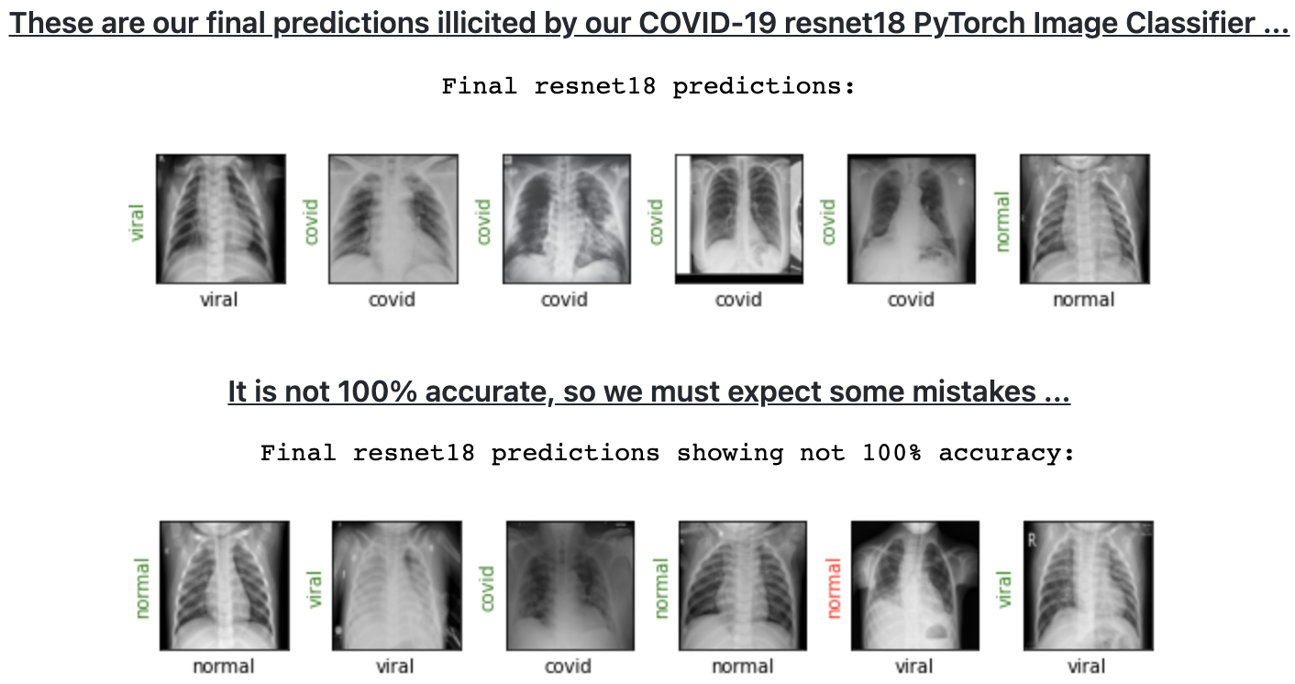
MODEL EVALUATION/RESULTS
Notes:
THIS RESNET18 IMAGE CLASSIFIER IMPLEMENTED USING PYTORCH ULTIMATELY PREDICTED WITH 95.6 ACCURACY WHETHER THE X-RAY SHOWED SOMEONE BEING NORMAL, VIRAL, OR WITH COVID-19
WE MUST KEEP IN MIND THAT IT IS NOT 100% ACCURATE, SO WE MUST EXPECT SOME MISTAKES TO BE MADE.

Slide 9

FUTURE WORK
PLAY AROUND WITH THE LEARNING RATE
USE ALTERNATIVE OPTIMIZER WHEN CONSTRUCTING NEURAL NETWORK
INCREASE TRAINING DATA
Notes:
FOR FUTURE WORK WE CAN PLAY AROUND WITH THE LEARNING RATE AND ADJUST IT TO POSSIBLY INCREASE OUR ACCURACY
THE ADAM OPTIMIZER WAS USED WHEN CONSTRUCTING THE NEURAL NETWORK, BUT WE CAN CHOOSE TO USE A DIFFERENT ONE AND SEE HOW OUR RESULTS CHANGE
WE NEED VAST AMOUNTS OF DATA TO BE READILY AVAILABLE IN ORDER TO TRAIN MODELS LIKE THIS EVEN FURTHER AND THIS IS SOMETHING WE MUST PRIORITIZE IN THE TIME TO COME.

Slide 10

THANK YOU
Notes:
- THANK YOU FOR YOUR TIME

